Slide 1

Data Visualization of Bird Strikes between 2000 – 2011

Slide 2
Introduction
Objective: Analyze and visualize bird strike data over 11 years.
Bird Strike data collected on Bird Strikes by FAA between 2000-2011.
Bird Strike is common and can be a significant threat to aircraft safety, significant damage may be caused to the aircraft structure.

Slide 3
Data Overview
Time Period: 2000 to 2011.
Key Metrics: Type of Aircraft, Number of strikes, Impact to flight, Indicated Damage, Number of engines, Phase of flight, Conditions of Sky, Wildlife: Species, Total cost of repaired, height above ground, Number of people injured.

Slide 4
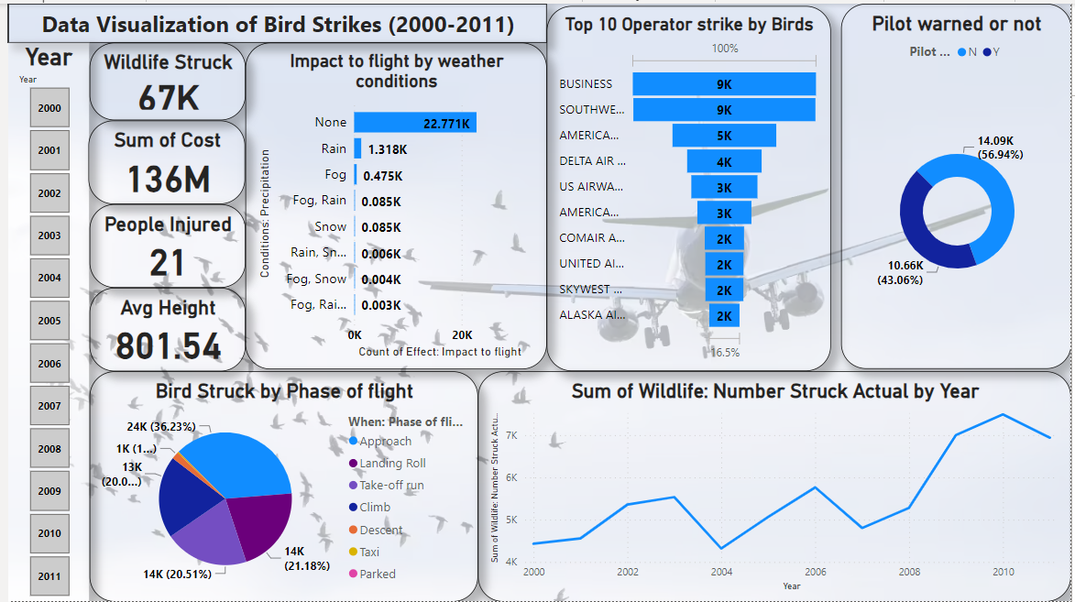
Dashboard (power bi)

Slide 5
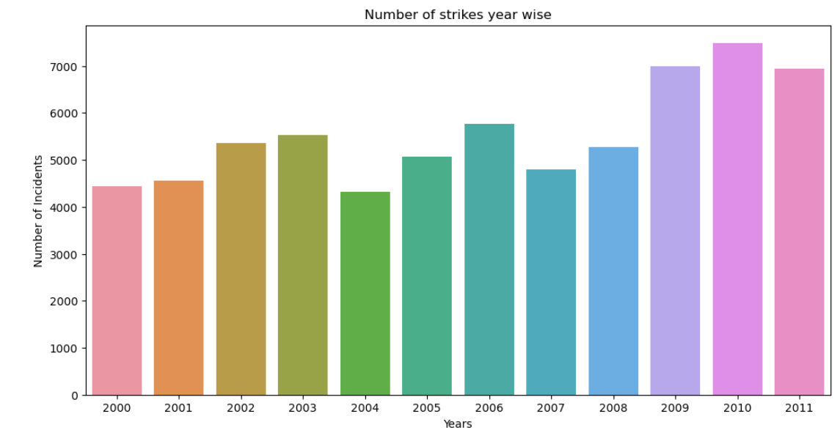
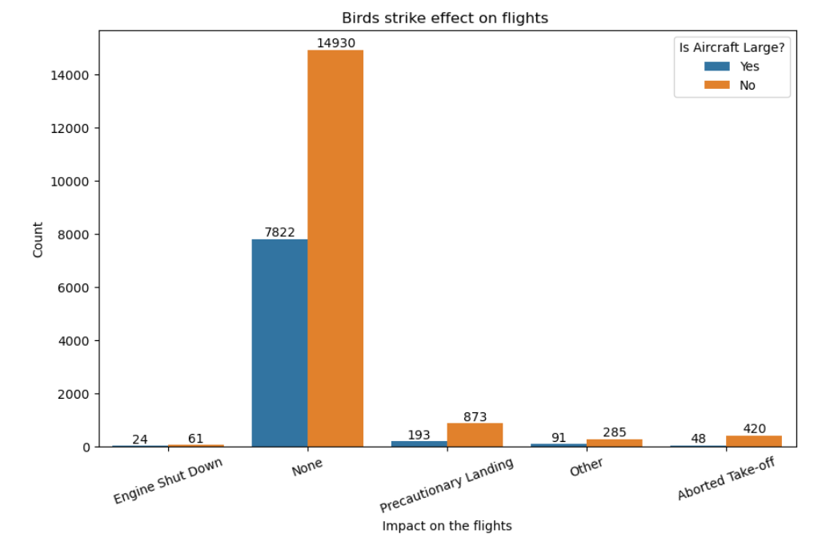
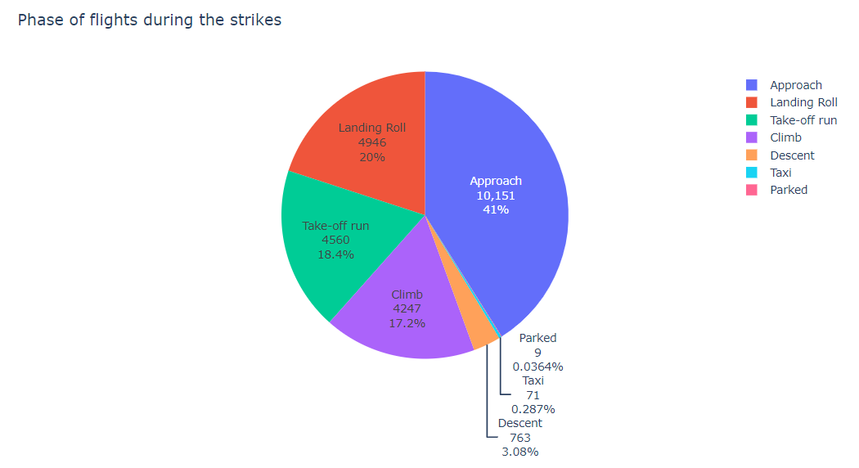
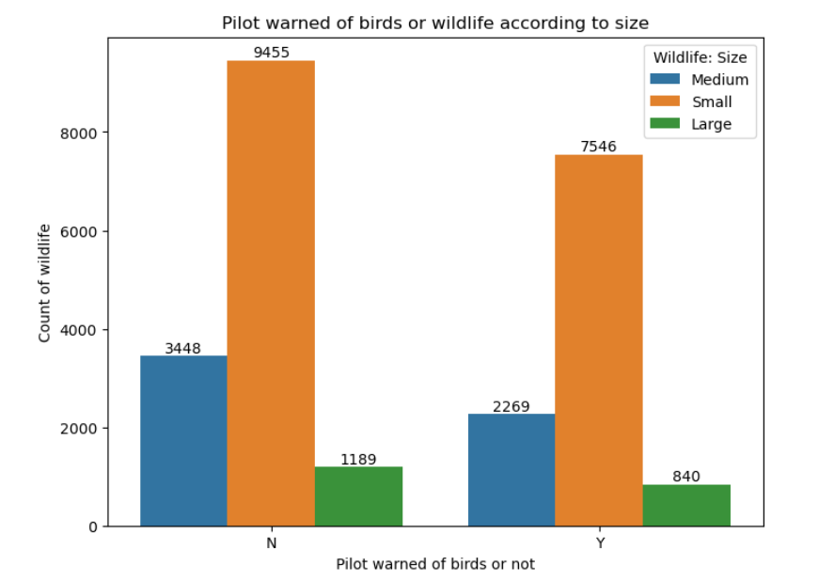
Analysed graphs

Slide 6
Recommendations/Conclusion
Mitigation Strategies: Enhanced bird control measures during peak seasons.
Aircraft Design: Consideration of strike data in designing more resilient aircraft.
Policy Updates: Strengthening of regulations on wildlife management near airports.
Impact: Understanding bird strike patterns helps improve aviation safety.
Future Work: should Continue data analysis and updating of bird strike mitigation measures.

Slide 7

Heart Disease Diagnostic Analysis

Slide 8
Introduction
Objective: To identify key predictors of heart disease using statistical analysis using analytical tools.

Slide 9
Data Overview
Key Metrics: age, sex, chest pain type, resting blood pressure, cholesterol, fasting blood sugar, common blood test, diabetes or gestational diabetes, resting electrocardiographic results Thalassemia, ST segment, Coronary artery disease.

Slide 10
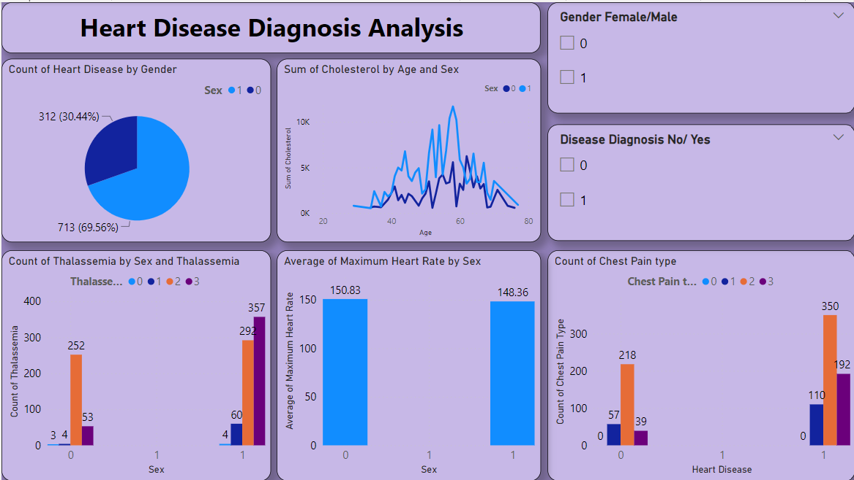
Dashboard (power bi)

Slide 11
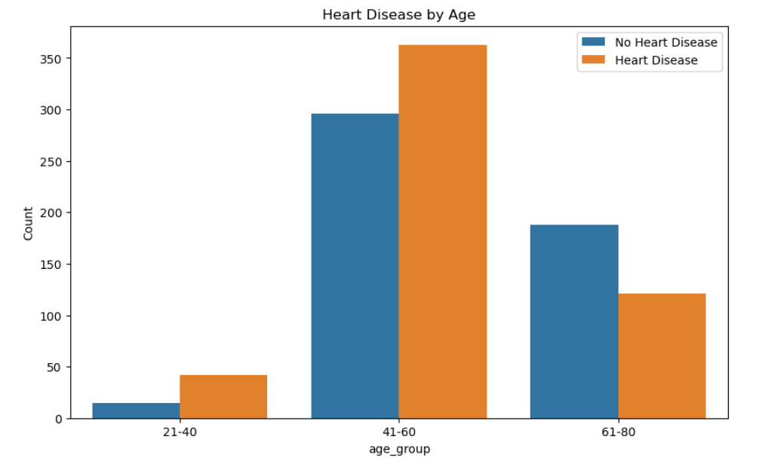
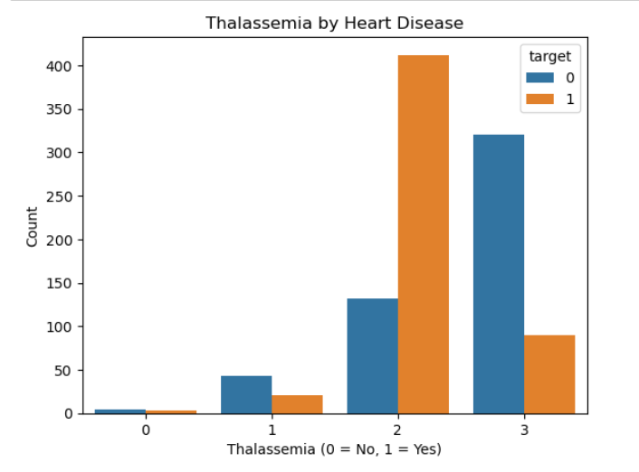
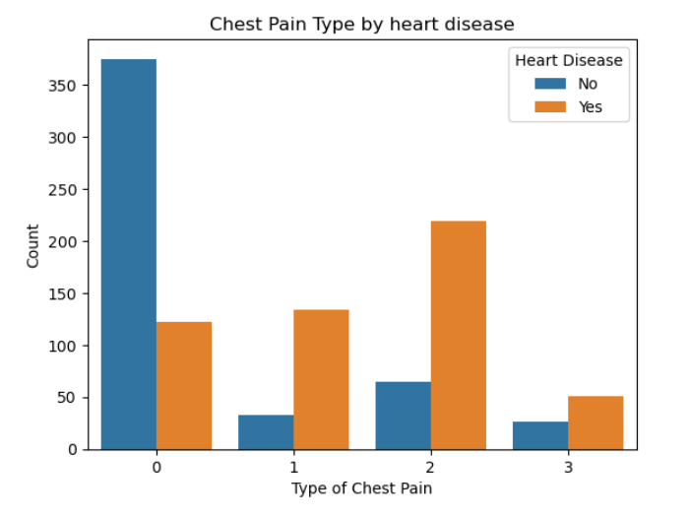
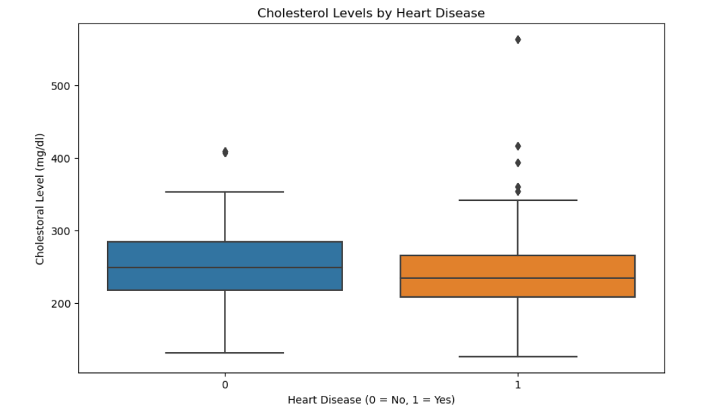
graphs

Slide 12
Recommendations/Conclusion
Preventive Measures: Regular health screenings, Lifestyle changes (diet, exercise).
Clinical Interventions: Targeted treatments for high-risk individuals.
Impact: Early diagnosis can significantly reduce mortality rates.
Future Work: Further research with larger and more diverse datasets.

Slide 13
Thank you

